Slide 1
Why worry about complex syntax?
Nick Riches
What is complex syntax?
Why worry about complex syntax?
In which contexts does complex syntax occur?
Complex syntax in school texts
Complex syntax in other texts
Nick Riches
What drives syntactic complexity?
Talking about complex things
Examples of expository discourse
Newcastle University
compiled on March 20, 2019
Expository Discourse and Language Impairment
Bibliography
1 / 19

Slide 2
Why worry about complex syntax?
Nick Riches
What is complex syntax?
What is complex syntax?
In which contexts does complex syntax occur?
Complex syntax in school texts
Complex syntax in other texts
In which contexts does complex syntax occur?
What drives syntactic complexity?
What drives syntactic complexity?
Talking about complex things
Examples of expository discourse
Expository Discourse and Language Impairment
Bibliography
Expository Discourse and Language Impairment
Bibliography
1 / 19

Slide 3
Why worry about complex syntax?
Nick Riches
What is complex syntax?
In which contexts does complex syntax occur?
Complex syntax in school texts
Complex syntax in other texts
Complexity within phrases
(1) [ the big hair biker ] stroked [ the cute little purring kitten ]
What drives syntactic complexity?
Talking about complex things
Examples of expository discourse
(2) The mouse [ that the cat chased ] was very mischievous
Expository Discourse and Language Impairment
Bibliography
2 / 19

Slide 4
Why worry about complex syntax?
Nick Riches
What is complex syntax?
In which contexts does complex syntax occur?
Complex syntax in school texts
Complex syntax in other texts
Complexity at the clause level
What drives syntactic complexity?
Talking about complex things
Examples of expository discourse
There’s the cat [ _{Obj. rel.} that the dog chased ]
The cat was chased _{Passive} by the dog.
Expository Discourse and Language Impairment
Bibliography
3 / 19

Slide 5
Why worry about complex syntax?
Nick Riches
What is complex syntax?
What is complex syntax?
In which contexts does complex syntax occur?
Complex syntax in school texts
Complex syntax in other texts
In which contexts does complex syntax occur?
What drives syntactic complexity?
What drives syntactic complexity?
Talking about complex things
Examples of expository discourse
Expository Discourse and Language Impairment
Bibliography
Expository Discourse and Language Impairment
Bibliography
3 / 19

Slide 6

Complex syntax in school texts
Why worry about complex syntax?
Nick Riches
What is complex syntax?
In which contexts does complex syntax occur?
Complex syntax in school texts
Complex syntax in other texts
What drives syntactic complexity?
Talking about complex things
Examples of expository discourse
Expository Discourse and Language Impairment
Bibliography
4 / 19

Slide 7
Complex syntax in school texts
Why worry about complex syntax?
Nick Riches
(5)
Botanists claim that some wildflowers, such as blazing stars, grow well in grasslands.
What is complex syntax?
In which contexts does complex syntax occur?
Complex syntax in school texts
Complex syntax in other texts
(6)
Most grasslands are populated by large herds of grazing animals, such as bison, a species of mammal native to the American prairies. . . Millions of bison, commonly known as buffalo, once ranged over the American prairie, where they were preyed upon by wolves, coyotes, and humans. (Biggs et al., 2002, p. 83)
What drives syntactic complexity?
Talking about complex things
Examples of expository discourse
(7)
Other important prairie animals include prairie dogs, which are seed-eating rodents that build underground ‘towns’ known to stretch across mile after mile of grassland, and the foxes and ferrets that prey on them. (Biggs et al, 2002, p. 83)
Expository Discourse and Language Impairment
Bibliography
(source: presentation by Marilyn Nippold at the RCLST)
5 / 19

Slide 8
Complex syntax in school texts
Why worry about complex syntax?
Nick Riches
What is complex syntax?
In which contexts does complex syntax occur?
Complex syntax in school texts
Complex syntax in other texts
Botanists claim [ _{Od} that some wildflowers, such as blazing stars, grow well in grasslands ].
What drives syntactic complexity?
Talking about complex things
Examples of expository discourse
Expository Discourse and Language Impairment
Bibliography
6 / 19

Slide 9
Complex syntax in school texts
Why worry about complex syntax?
Nick Riches
What is complex syntax?
In which contexts does complex syntax occur?
Complex syntax in school texts
Complex syntax in other texts
PASSIVES and
RELATIVE CLAUSES
Most grasslands are populated by large herds of grazing
animals, such as bison, a species of mammal native to the American prairies. . . Millions of bison,
What drives syntactic complexity?
Talking about complex things
Examples of expository discourse
(that are)
commonly known as buffalo, once ranged over
the American prairie,
Expository
where they were preyed upon by wolves, coyotes, and humans.^{course and}
Dis
La
nguage
(Biggs et al., 2002, p. 83)
Impairment
Bibliography
7 / 19

Slide 10
Complex syntax in school texts
Why worry about complex syntax?
Nick Riches
What is complex syntax?
In which contexts does complex syntax occur?
Complex syntax in school texts
Complex syntax in other texts
PASSIVES
[ Relative clauses in brackets ]
Other important prairie animals include prairie dogs,
What drives syntactic complexity?
Talking about complex things
Examples of expository discourse
[ which are seed-eating rodents
[that build underground ‘towns’
[ (that are) known to stretch across mile after mile of grassland^{tory}
Exposi
Discou
rse and
] ] ] , and the foxes and ferrets [ that prey on them ].
Language
Impairment
Bibliography
8 / 19

Slide 11
Complex syntax in other texts
Why worry about complex syntax?
Nick Riches
What is complex syntax?
In which contexts does complex syntax occur?
Complex syntax in school texts
Complex syntax in other texts
Complex texts are found in any job which involves understanding complex systems (Rose, 1989)
What drives syntactic complexity?
Talking about complex things
Examples of expository discourse
Expository Discourse and Language Impairment
Bibliography
9 / 19

Slide 12
Why worry about complex syntax?
Nick Riches
What is complex syntax?
What is complex syntax?
In which contexts does complex syntax occur?
Complex syntax in school texts
Complex syntax in other texts
In which contexts does complex syntax occur?
What drives syntactic complexity?
What drives syntactic complexity?
Talking about complex things
Examples of expository discourse
Expository Discourse and Language Impairment
Bibliography
Expository Discourse and Language Impairment
Bibliography
9 / 19

Slide 13
Talking about complex things
Why worry about complex syntax?
Nick Riches
What is complex syntax?
In which contexts does complex syntax occur?
Complex syntax in school texts
Complex syntax in other texts
Our language gets more complex when we start to talk about complex things, e.g. the rules of a running race versus the rules of a game of football.
A discourse in which we describe a complex body of knowledge is called an ‘expository’ discourse (exposition
= explanation).
What drives syntactic complexity?
Talking about complex things
Examples of expository discourse
Expository Discourse and Language Impairment
Bibliography

Slide 14
Talking about complex things
Why worry about complex syntax?
Nick Riches
What is complex syntax?
In which contexts does complex syntax occur?
Complex syntax in school texts
Complex syntax in other texts
Good prompts for expository discourse
Tell me the rules of your favourite sport or game
How would you solve a particular conflict between peers? (Nippold et al. 2007)
Tell me what you learnt in school today.
What drives syntactic complexity?
Talking about complex things
Examples of expository discourse
Expository Discourse and Language Impairment
Bibliography

Slide 15
Examples of expository discourse
Why worry about complex syntax?
Nick Riches
Data taken from Nippold (2008)
Here are individuals describing their favourite team game. What kind of complex structures are being used?
What is complex syntax?
In which contexts does complex syntax occur?
Complex syntax in school texts
Complex syntax in other texts
(8)
You just try to get a team. It doesn’t matter how many you need. You just got like six. Play three on three or something like that. And just get a football or something like a cup or something. And just play. Make a field and stuff.
What drives syntactic complexity?
Talking about complex things
Examples of expository discourse
(9)
So if the line gets past the offensive line, the offensive line on the other hand can’t just grab people and throw them out of their way. They have to push them. They can’t just pick them up and throw them out because then they will be called for holding, which is an illegal move. And you’ll get penalized 5 yards for that.
Expository Discourse and Language Impairment
Bibliography

Slide 16
Examples of expository discourse
Why worry about complex syntax?
Nick Riches
What is complex syntax?
In which contexts does complex syntax occur?
Complex syntax in school texts
Complex syntax in other texts
(10)
You just try to get a team. It doesn’t matter how many you need. You just got like six. Play three on three or something like that. And just get a football or something like a cup or something. And just play. Make a field and stuff.
What drives syntactic complexity?
Talking about complex things
Examples of expository discourse
Expository Discourse and Language Impairment
Bibliography

Slide 17
Examples of expository discourse
Why worry about complex syntax?
Nick Riches
What is complex syntax?
dependent/subordinate clause
relative clause | , | passive
, conjoined clause,
In which contexts does complex syntax occur?
Complex syntax in school texts
Complex syntax in other texts
(11)
So if the line gets past the offensive line, the
offensive line on the other hand can’t just grab
What drives syntactic complexity?
Talking about complex things
Examples of expository discourse
people and throw them out of their way. They
have to push them. They can’t just pick them
up and throw them out
Expository Discourse and Language Impairment
because then they will be called for holding
,
which is an illegal move. And
you’ll get penalized 5 yards for that.
Bibliography
14 / 19

Slide 18
Why worry about complex syntax?
Nick Riches
What is complex syntax?
What is complex syntax?
In which contexts does complex syntax occur?
Complex syntax in school texts
Complex syntax in other texts
In which contexts does complex syntax occur?
What drives syntactic complexity?
What drives syntactic complexity?
Talking about complex things
Examples of expository discourse
Expository Discourse and Language Impairment
Bibliography
Expository Discourse and Language Impairment
Bibliography
14 / 19

Slide 19
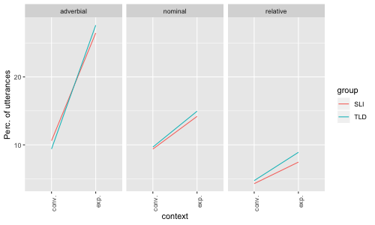
Why worry about complex syntax?
Data from Nippold et al. 2008
Types of dependent clause (‘nominal’ = clause in complement position)
Nick Riches
What is complex syntax?
In which contexts does complex syntax occur?
Complex syntax in school texts
Complex syntax in other texts
What drives syntactic complexity?
Talking about complex things
Examples of expository discourse
Expository Discourse and Language Impairment
Bibliography

Slide 20
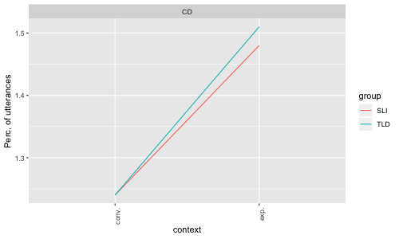
Why worry about complex syntax?
Nick Riches
Clausal Density
What is complex syntax?
In which contexts does complex syntax occur?
Complex syntax in school texts
Complex syntax in other texts
What drives syntactic complexity?
Talking about complex things
Examples of expository discourse
Expository Discourse and Language Impairment
Bibliography

Slide 21
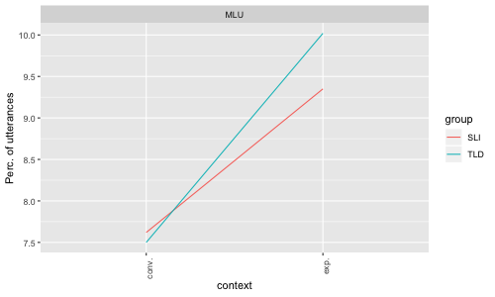
Why worry about complex syntax?
Nick Riches
What is complex syntax?
In which contexts does complex syntax occur?
Complex syntax in school texts
Complex syntax in other texts
What drives syntactic complexity?
Talking about complex things
Examples of expository discourse
Expository Discourse and Language Impairment
Bibliography

Slide 22
Why worry about complex syntax?
Nick Riches
What is complex syntax?
In which contexts does complex syntax occur?
Complex syntax in school texts
Complex syntax in other texts
Take home message:
Consider the relationship between genre and complexity
Can particular genres be used to elicit and treat complex structures?
What drives syntactic complexity?
Talking about complex things
Examples of expository discourse
Expository Discourse and Language Impairment
Bibliography
18 / 19

Slide 23
Why worry about complex syntax?
Nick Riches
What is complex syntax?
What is complex syntax?
In which contexts does complex syntax occur?
Complex syntax in school texts
Complex syntax in other texts
In which contexts does complex syntax occur?
What drives syntactic complexity?
What drives syntactic complexity?
Talking about complex things
Examples of expository discourse
Expository Discourse and Language Impairment
Bibliography
Expository Discourse and Language Impairment
Bibliography
18 / 19

Slide 24
Why worry about complex syntax?
Nick Riches
What is complex syntax?
Nippold, M. A. (2010). Explaining Complex Matters: How Knowledge of. Expository Discourse in Children, Adolescents, and Adults: Development and Disorders, 41.
Nippold, M. A., Hesketh, L. J., Duthie, J. K., & Mansfield, T. C. (2005). Conversational versus expository discourse: A study of syntactic development in children, adolescents, and adults. Journal of Speech, Language and Hearing Research, 48(5), 1048.
In which contexts does complex syntax occur?
Complex syntax in school texts
Complex syntax in other texts
What drives syntactic complexity?
Talking about complex things
Examples of expository discourse
Nippold, M. A., Mansfield, T. C., & Billow, J. L. (2007). Peer Conflict Explanations in Children, Adolescents, and Adults: Examining the Development of Complex Syntax. American Journal of Speech-Language Pathology, 16(2), 179-188. https://doi.org/10.1044/1058-0360(2007/022)
Nippold, M. A., Mansfield, T. C., Billow, J. L., & Tomblin, J. B. (2008). Expository discourse in adolescents with language impairments: Examining syntactic development. American Journal of Speech-Language Pathology, 17(4), 356.
Expository Discourse and Language Impairment
Bibliography
Nippold, M. A., & Scott, C. M. (2010). Expository discourse in children, adolescents, and adults: Development and disorders. Taylor & Francis US.
19 / 19

